Slide 1
Lewisham Main Grants Consultation - Reminder
The Main Grants consultation is now open and the outcome will inform the funding round opening for applications in July 2025.
You can find out more and share your views here:
Lewisham Council - Main Grants Consultation
Please share your views before
25th May 2025
Notes:
Sarah
Slides with link will be shared following meeting.

Slide 2
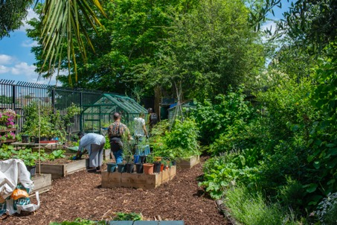
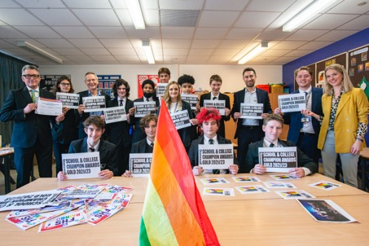
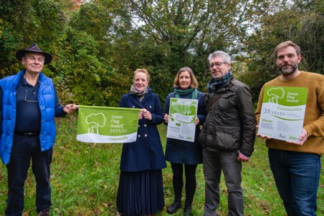
NCIL Mobilisation
Spring/Summer 2025
Notes:
Sarah
Welcome to the session – first of three sessions, so please share feedback if you think there are improvements we could make
There will be Q&As and breakout rooms at the end of the meeting – if we can’t answer, we’ll get back to you.
If you have questions during the presentation, please make a note of them or pop them in the chat and we’ll respond at the end.
We will share FAQs following the meetings.
If you need to zoom in on the presentation, there are three dots in the bottom left of the screen, please click on those and you will see an option to ‘magnify slide only for me’.

Slide 3
Introductions
Notes:
Sarah –
Invite Community Development Officers to introduce themselves.
Sadly, not time to individually introduce yourselves, so please add your name and organisation to the meeting chat.
Hands up if this your first NCIL funded project - welcome – and support from experienced orgs in the room.

Slide 4
Agenda
Overview
NCIL programme for 2025-2027, mobilisation improvements, what needs to be done, and by when?
Grant Agreement
How to complete it and pages to review prior to signing
Monitoring
Why monitoring is important, how to collect data, how to complete monitoring forms, meetings with monitoring officers
What help is available?
Who is my Monitoring Officer and what other sources of help are available?
…And finally…
Timelines, any broad questions and break out rooms for specific questions
Notes:
Sarah –
Colleagues presenting today:
NCIL 25-27 so far - Katie
Grant Agreement - Grace
Monitoring - Sara
What help is available? - Lucy
…And finally… - Paul
Following the presentation, chance to go into breakout rooms for project-specific questions,
general questions can be added to the chat throughout the presentation and these will be grouped and answered at the end
You can zoom in on the presentation by…

Slide 5
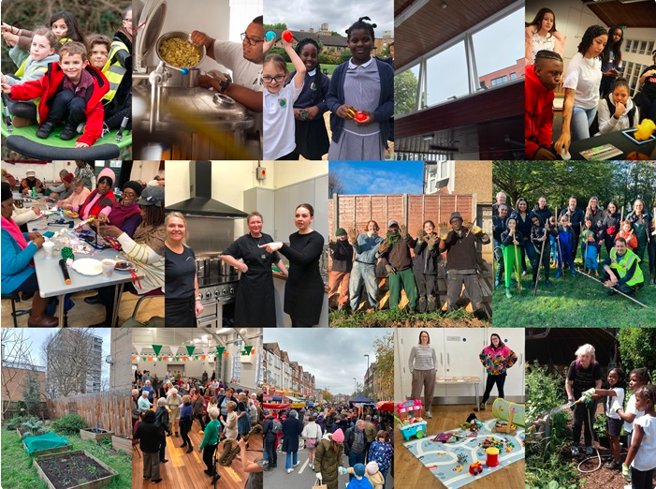
NCIL 25-27 overview

Slide 6
Applications for 2025-2027
A Strong Local Economy
Safer Communities
Children and Young People
NCIL priorities
Funding available
Open-call applications
Number of projects awarded funding
(open-call and council-led)
Health and Wellbeing
Open Lewisham
Cleaner and Greener
Borough-wide:
£621,733
Ward-based:
£1,931,510
246 applications received
Totalling £9.2m
137
Notes:
Katie
For info if required - projects awarded funding
16 x Borough-wide,
8 x Bellingham, 7 x Blackheath,
7 x Brockley, 6 x Catford South,
3 x Crofton Park, 12 x Deptford,
7 x Downham, 12 x Evelyn,
6 x Forest Hill, 4 x Grove Park,
8 x Hither Green, 3 x Ladywell,
5 x Lee Green, 4 x Lewisham Central,
10 x New Cross Gate, 2 x Perry Vale,
7 x Rushey Green, 6 x Sydenham,
4 x Telegraph Hill

Slide 7
Mobilisation for NCIL 2025-2027
1. Updated the application form and guidance
2. Added a supplementary questionnaire to confirm project details and/or to capture any changes
4. Aligned project start dates and payment schedules
3. Set up a process to pull key information through to the Grant Agreement and monitoring documents
Notes:
Katie
The approach was adjusted in this round of NCIL to ease the process of mobilisation.
1) Updated app form and guidance
2) Added a supplementary questionnaire (shared following confirmation of Mayor & Cabinet sign-off)
3) Set up a process to pull key information through:
organisational details and key contacts
monitoring details such as outputs and outcomes (or revised outputs and/or outcomes if projects were offered reduced funding)
the budget, programme and timeframe and any changes
4) Aligned schedules for project start dates and payments - to make monitoring more straightforward and be clear about what is needed and by when and when payments are scheduled to be made.

Slide 8
What needs to be done and by when?
Already completed:
Following today’s
Mobilisation session:
Once all initial paperwork is completed:
Supplementary survey (by each organisation)
Payments made according to your individual payment schedule
Official project launches
(from 1st July 2025 onwards)
Keep an eye on your email for your Grant Agreement and payment schedule and contact us with any questions
Regular monitoring completed
(as required)
Share any requested policies by the start of your project
(e.g. Safeguarding Policy, Certificate of Public Liability Insurance)
Project Closure report
(by 30th September 2027
at the latest)
Notes:
Katie
Official Launch - Re 1st July, if you have had a conversation with your monitoring officer the start date may vary.
Monitoring completed - Monitoring completed as one-offs following an event or series of events, otherwise quarterly for the duration of the project
Project closure – If project is one off or shorter than 2 years or is a one-off event, we’ll let you know when your closure report will be due.

Slide 9
Grant Agreement

Slide 10
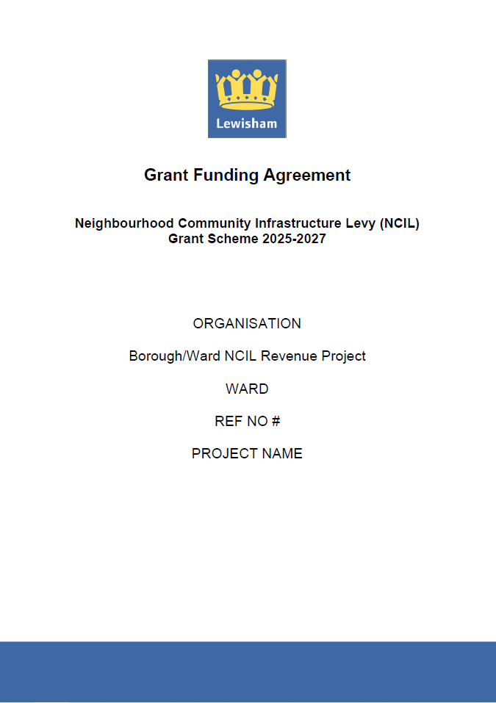
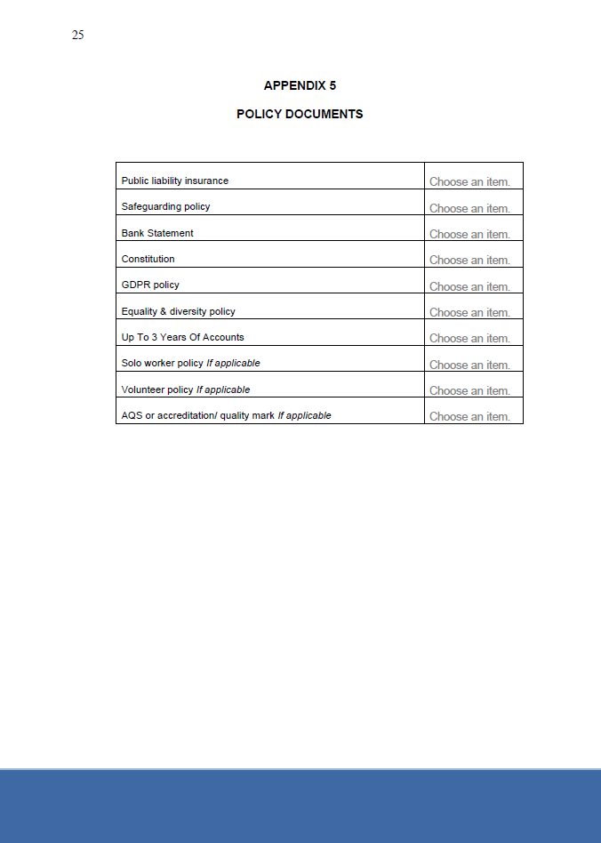
Grant Agreement
Notes:
Grace
Quite a long document, going through a few pages so it’s less daunting, highlighting a couple of the key pages. All of these pages will be completed, but if you notice any errors, please do let us know. Along with these pages are the terms and conditions, please do have a read through these and let us know if you require any clarifications.
Front page
All info fed through from the supplementary form
Includes ref no and project name, when getting in touch with us, where possible please mention your ref no and project name.
Policy Docs
These policies will be familiar to you as we had requested them at due diligence stage. For those who have said they’ll be sending in outstanding documents prior to the start of their project, we will have reached out to you with a gentle reminder to send these in prior to your project starting.

Slide 11
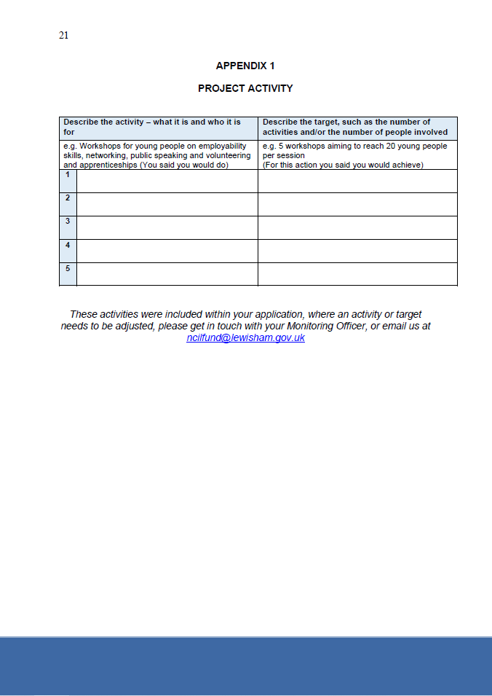
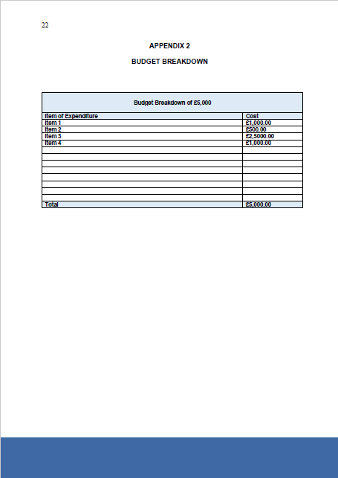
Grant Agreement
Notes:
Grace
Project Activity and Budget Breakdown
Again, these pages will be pre-filled. Where you have provided information within your supplementary form that differs from your application, for example you’ve been awarded less so your budget breakdown has changed, we will have included your updated information here. When you receive your agreement, please do have a read through and let us know if anything needs to change. This is not to say that this means your activities are set in stone, if anything changes after your agreement has been signed, please do just get in touch with your monitoring officer and these can be looked at.

Slide 12
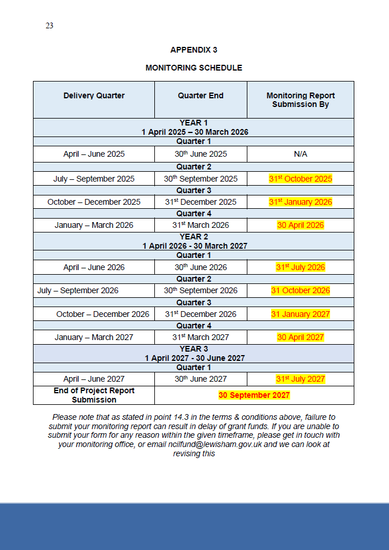
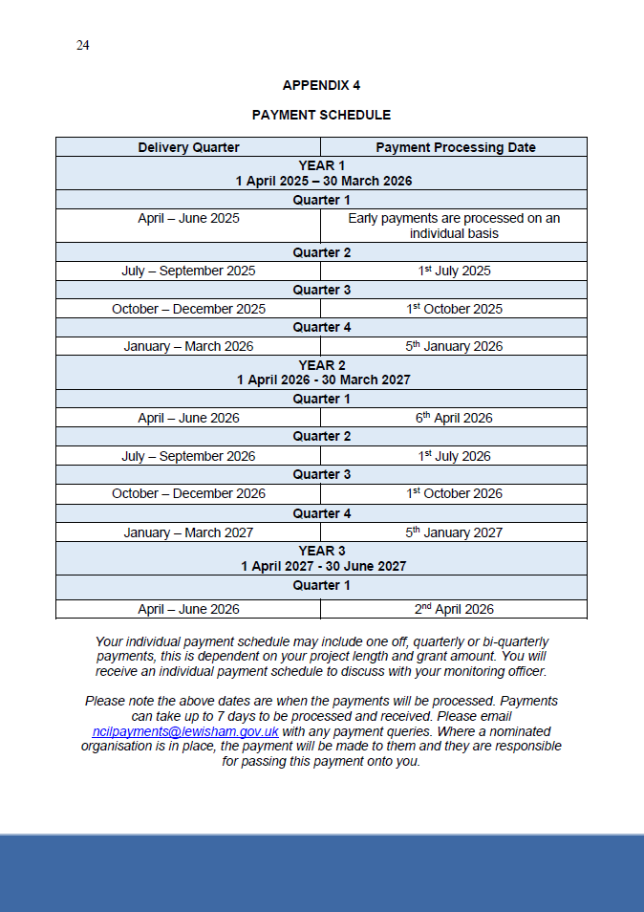
Grant Agreement
Notes:
Grace
Monitoring Schedule
The monitoring schedule is highlighted at the moment as we will amend this to reflect the monitoring dates that relate to your project. These are the dates that your monitoring forms should be received by, as my colleague Sara will talk about in a bit, these are really important dates and where monitoring isn’t received, it could affect your next grant payment.
Payment Schedule
The payment schedule you’ll see within your agreement will cover the full length of the project, however your monitoring officer will go through an individual payment schedule with you. While we will have pre-filled the dates and amounts, it’s not set in stone and you will have the opportunity to amend the amount and frequency of payments. It’s our aim that you’ll receive these payment schedules within the next week or so.

Slide 13
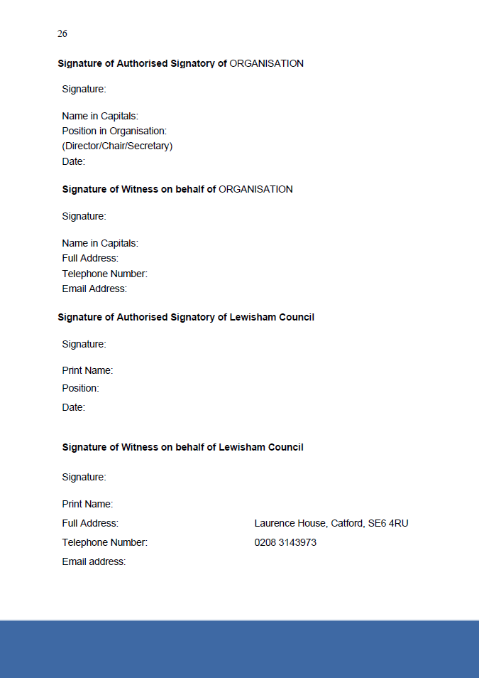
Grant Agreement
Notes:
Grace
Signature page
This will be the final page of your agreement. This will be sent via docusign to the email address included within your supplementary form, once you have signed this, it will be automatically sent to your witness, using the details within the supplementary form. While they will receive an email about this, it may be worth just speaking with them to look out for the link so the agreement isn’t held up. Once signed, it’ll be for us at the council to provide the final two signatures. Once that’s completed, you will receive a final copy of the signed agreement.

Slide 14
Monitoring
July 2025 - September 2027

Slide 15
Introduction
As part of your grant agreement, we will be monitoring your project. To help with this, we’ve put together this guidance which covers:
How monitoring
works
Completing your monitoring reports
Our expectations of you
What you can expect from us
Guidance on collecting demographics
Best practice
Notes:
Sara

Slide 16
Why do I need to share monitoring information?
NCIL = public money
NCIL legal obligations
Reflection. What is working well? What might be further developed?
Flag issues early. What support is needed for effective delivery?
Demonstrate impact
Showcase successes
Allow us to help promote your project
Good practice examples (e.g. To attract further funding)
Notes:
Sara –
NCIL is public money, and we need to be accountable for how it has been spent
To ensure legal obligations for NCIL have been met
To enable your organisation to reflect on what is working well and what might be further developed
To flag any concerns or support required to enable effective delivery
To demonstrate the impact that your projects have on our residents, including by priority, or theme. We get asked by lots of different stakeholders – councillors, senior officers, at local level but also London-wide forums ask for impact info through different lenses. Protected characteristics, areas, etc
To showcase the successes of the project so that we can share these both within the borough and externally if required (e.g. when seeking further funding for Lewisham)

Slide 17
How monitoring works
Monitoring officer assigned
May 2025
Agree outputs and outcomes as part of signing your grant agreement
Project monitored through quarterly reports and monitoring meetings
Meet with your monitoring officer May/June 2025
Notes:
Sara
Your project will be monitored by your monitoring officer.
You will meet with your monitoring officer during the mobilisation period (May - June 2025).
Your monitoring officer will ensure that the outputs and outcomes for your project are clear before you sign your grant agreement.
Your project will be monitored through quarterly reports and monitoring meetings.

Slide 18
Quarterly reporting schedule
Reporting follows a fixed schedule for up to two years, starting from July 2025 (unless you’ve been given permission to start early):
April – June 2025 (only for agreed early start projects)
April – June 2026
July – September 2026
July – September 2025
October – December 2026
October – December 2025
January – March 2027
January – March 2026
April – June 2027
* A 6 month project, will only require two completed quarterly reports
When your project is complete (or for large projects over £30,000), your quarterly report will show some additional questions regarding your expenditure. This will act as your final report.
Notes:
Sara
Remind about the deadlines on this slide - must be submitted one month after the end of the quarter
A one-off event – only one form

Slide 19
Quarterly Monitoring Reports
How do I complete the report?
Every 3 months we’ll send you a unique link to complete an online form
Your monitoring officer can help
Submit it no later than one month after the end of the quarter
Your next grant payment will be delayed
You will have a monitoring meeting with your monitoring officer
What if I need support?
How long will I have to submit my report?
What if I don’t submit my report on time?
What happens after submitting my report?
Notes:
Sara
Reiterate about the deadline and make it clear how many projects each monitoring officer is having to oversee and how we haven’t got time to chase reports
Monitoring of Main Grants, small team,

Slide 20
What will I need to report on?
Outputs as numbers against your agreed targets
Number of sessions delivered, Number of beneficiaries reached, number of surveys completed, etc.
Narrative on how things are going
Comments on successes, challenges, the impact of your project or unexpected developments.
Demographics data on your beneficiaries
Data on Protected Characteristics, socio-economic status OR a rough idea of the type or people you are reaching.
Evidence of project success
Photographs, case studies or other evidence that shows your project’s successes
Notes:
Sara
Show an example of how content provided can help with project promotion e.g. Max Media Arts news article

Slide 21
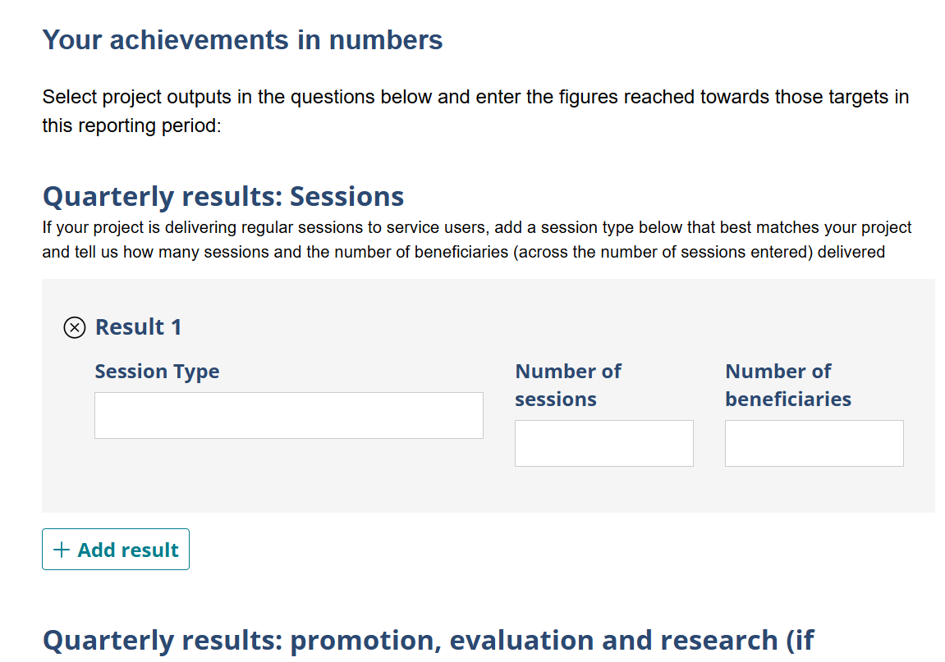
Monitoring Report Demo
Notes:
Sara
Recording will be made and link will be sent in advance of completion of form
Data collection sheet
1. Share a Window (Website):
While sharing your presentation, open the website you want to display in a separate browser window.
In the Teams meeting controls, select "Share".
Choose the "Window" option.
Select the specific browser window containing the website.
The website will now be shared instead of the PowerPoint.
2. Switch Between PowerPoint and Website:
When you want to return to your PowerPoint, select "Stop sharing" in the meeting controls.
Then, select "Share" again and choose the "PowerPoint Live" option.
This will allow you to resume sharing the PowerPoint presentation.

Slide 22
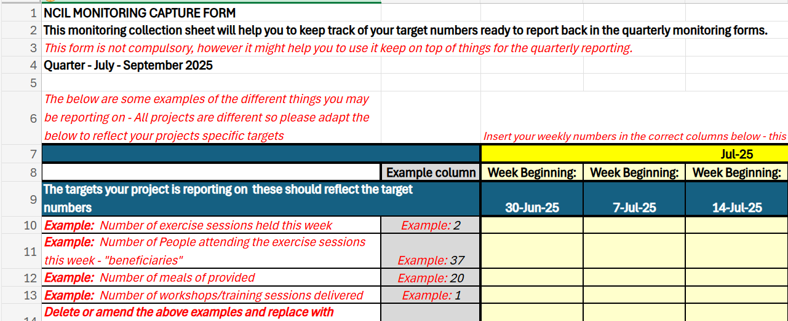
How will I share information about my project?
Notes:
Sara - Recording will be made and link will be sent in advance of completion of form
Data collection sheet

Slide 23
Meeting with your Monitoring Officer
How often?
Quarterly, after you submit your report.
This could be a quick catch up, or a longer meeting, if needed, but usually an hour will be scheduled in.
Most meetings will take place online via Teams, but your monitoring officer may also come to visit your project and meet face to face.
How your project is going, any challenges you may be facing with project delivery, any support you may need. Your Monitoring Officer will update your quarterly report with any actions that were agreed at the meeting and this will be shared with you in a follow up email.
How long for?
Where?
What will we discuss?
What happens afterwards?
Notes:
Sara

Slide 24
Our expectations and what you can expect from us
We will:
We expect you to:
Provide a user-friendly way to report back on your project
Submit reports on time and report any issues or delays as soon as possible
Meet with you quarterly
Report stats on your targets quarterly and provide evidence of your project’s success and expenditure by the end of your project
Offer direct support, put you in touch with Council departments as needed as well as relevant support networks or services
Report on as much demographics data as you have capacity for, even if this is light touch / anecdotal
Ensure payments are made on time
Meet with your monitoring officer quarterly
Notes:
Sara

Slide 25
Monitoring: Collecting and reporting on demographic data

Slide 26
Demographic data: why it matters
Measuring Impact
Is the programme reaching and serving a diverse and representative group of people? Can we identify and address gaps in access or participation?
Who is benefiting from the programme? Do outcomes vary across different groups?
How can we better allocate resources where they’re most needed?
Can we show that public funds are being used effectively and equitably?
Ensuring Equity and Inclusion
Informing Future Funding Decisions
Accountability and Transparency
Notes:
Sara
Stats are analysed to inform future work and to ensure funding programmes are evidenced effectively to ensure continuation. Vital for keeping grant funding.

Slide 27
What data could you collect
Protected Characteristics (UK Equality Act 2010):
Age Disability Gender reassignment Marriage and civil partnership Pregnancy and maternity Race Religion or belief Sex Sexual orientation
Household income level Sanctuary Seeker / NRPF Status Employment status Carers Educational Background Postcode Financial hardship indicators (e.g., access to free school meals, housing benefits)
Additional Socioeconomic Indicators:
Notes:
Sara
Aim to collect as much as possible, but as a minimum we would like age, race, sex

Slide 28
What data could you collect - continued
Protected Characteristic | Categories
Age | Under 18, 18-24, 25-34, 35-44, 45-54, 55-64, 65+
Disability | Yes, No, Prefer not to say
Gender reassignment | Yes, No, Prefer not to say
Marriage and civil partnership | Married, Civil partnership, Single, Divorced, Widowed, Prefer not to say
Pregnancy and maternity | Pregnant, On maternity leave, Not applicable, Prefer not to say
Race | White; Black, Black British, Caribbean or African; Asian or British Asian; Mixed/Multiple ethnic groups; Other (please specify); Prefer not to say
Religion or belief | Christian, Muslim, Hindu, Jewish, Buddhist, Sikh, No religion, Other, Prefer not to say
Sex | Male, Female, Non-binary, Prefer not to say
Sexual orientation | Heterosexual, Homosexual, Bisexual, Other, Prefer not to say
Socioeconomic factors could be things like: On benefits, Free school meals, Sanctuary Seeker / NRPF status, Postcode, Employment status, etc
See ONS guidance: https://www.ons.gov.uk/methodology/classificationsandstandards/measuringequality/ethnicgroupnationalidentityandreligion
Notes:
Sara
Aim to collect as much as possible, but as a minimum we would like age, race, sex – if data is already being collected, they do not need to add all categories.
Ensure data is collected and stored according to your GDPR policy.

Slide 29
How to collect demographic data
Headcounts
Registration forms
Surveys
How to collect data? Do what works for your project
Interviews
Feedback forms
Focus groups
Notes:
Some elements only if it makes sense for the project
Surveys: Distribute anonymous surveys to participants during or after sessions or online.
Headcounts: During events, perform informal headcounts and estimate ages, genders, etc. This can provide useful demographic snapshots.
Registration Forms: Include optional demographic questions in registration forms for programs or events.
Feedback Forms: Use feedback forms to gather data on participants' experiences and backgrounds.
Interviews or focus groups, if relevant: Conduct informal interviews with participants to understand their demographic details and needs.

Slide 30
Tips for collecting demographic data
Anonymity and Confidentiality
Ensure participants know their data is collected confidentially. Emphasise the importance of measuring impact, using data to improve services. Use inclusive language and options to reflect diverse identities and experiences. Clearly communicate that demographic data collection is optional but encouraged. Use plain language to ensure accessibility. Collect data consistently each quarter to track changes and trends over time. Train staff on the importance of demographic data and how to collect it effectively and sensitively.
Explain why
Be Inclusive
Voluntary Participation
Clear and Simple Language
Consistency
Training
Notes:
Explain to service users why you are asking and why it matters – keeping funding going.
Even if not all users, data is still useful as a snapshot.

Slide 31
What help is available?
?

Slide 32
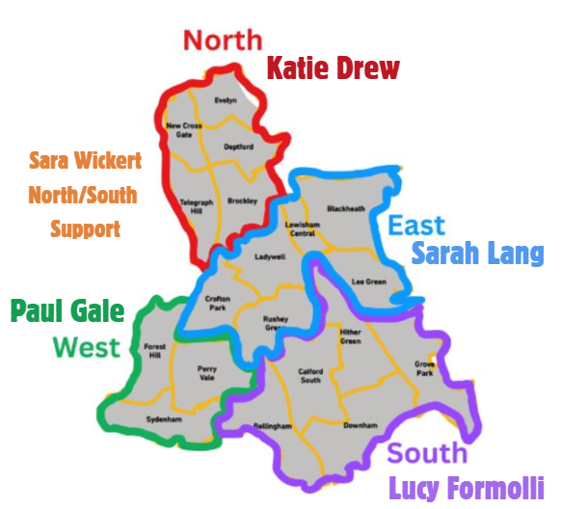
Monitoring Officers
Your first port of call for support should be your Monitoring Officer:
Katie Drew – katie.drew1@lewisham.gov.uk
North: Brockley, Deptford, Evelyn, New Cross Gate, Telegraph Hill
Lucy Formolli – lucy.formolli@lewisham.gov.uk
South: Bellingham, Downham, Grove Park, Hither Green, Catford South
Sarah Lang – sarah.lang@lewisham.gov.uk
East: Blackheath, Crofton Park, Ladywell, Lee Green, Lewisham Central, Rushey Green
Paul Gale – paul.gale@lewisham.gov.uk
West: Forest Hill, Perry Vale, Sydenham (and Positive Aging Council)
Sara Wickert – sara.wickert@lewisham.gov.uk Cross-ward support
Borough-wide projects will also be allocated a monitoring officer and you will be notified of your officer when we share your grant agreement
Notes:
Lucy –
Request support early - don’t wait if you have an issue, we want to work with you to get the project delivered.
Unforeseen changes may be needed, but we can work with you on those.

Slide 33
What additional support is available?
Community Funding Development Managers
Karen Jeffreys (Equalities)
Lewisham Local
karen@lewishamlocal.com
Chloe Booth (Arts)
Lewisham Education Arts Network
chloe@leanarts.org.uk
Leanne Wenham (Cold Spots)
Community Connections Lewisham (Age UK Lewisham & Southwark)
leanne.wenham@ageuklands.org.uk
Notes:
Lucy - Emphasise early support – don’t wait if you have an issue, we want to work with you to get the project delivered.
Unforeseen changes may be needed, but we can work with you on those.

Slide 34
What additional support is available?
We will share:
Slides from this meeting
A recording of the monitoring form demonstration
You can also contact:
Your Monitoring Officer
If your request is urgent and you are unable to reach your Monitoring Officer, please email – ncilfund@lewisham.gov.uk (including support with IT issues)
Community Funding Development Managers (as above)
A photo consent form template and other templates
Notes:
Lucy –
Community Funding Development Manager details on next slide

Slide 35
Promoting and engaging people with your project
www.eventbrite.co.uk
www.hootsuite.com
www.bitly.com
www.canva.com
www.docs.google.com/forms
Notes:
Lucy – Case studies and quotes will be useful for local newsletters, Lewisham Life email,
Possible tools e.g. Canva
Canva (Free for nonprofits): Design promotional material, social media graphics, flyers. www.canva.com a lovely and straightforward tool, with lots of templates that you can use to make your own to make impactful posters and flyers.
Eventbrite (Free for free events): Manage and promote community events. Which helps you to plan number coming, basic communication info, the amount of refreshments you need.
Google Forms: To gather feedback and engage your community. A great way to capture information for satisfaction surveys, case studies, quotes, - it generates reports for you. and you can download the information into excel which can help you with capturing you monitoring. Hootsuite (Free/Paid): Schedule and manage social media posts across platforms. www.hootsuite.com hoot suite helps you to schedule social media posts, taking the pressure off. if you have a team member or volunteer with social media skills, they can get a lot out of hootsuite planning your social media activity in advance. and monitoring its impact.
There are free or paid for versions of all of these, the paid version gives you more functionality. But the free versions are great.
Don’t forget social media. Instagramme, bluesky facebook, whatsapp – many people over 55 use whatsapp and facebook. – connect to your neighbourhood facebooks.
Our team have experience of using these tools and are happy to give you a demonstration at your convenince

Slide 36
How can Lewisham Council Comms support the promotion of your project
Residents’ E-Newsletter
Reaches over 26,000 subscribers every Thursday – a great way to share news and updates from across Lewisham directly with residents.
Lewisham Life Magazine
Delivered to every household in the borough, this print publication is ideal for reaching a wide and diverse audience.
Lewisham Council Facebook
With 11,000 followers, our Facebook page is perfect for sharing community news. We can also post directly into local community groups to boost visibility.
Lewisham Instagram
Our 7,600 followers engage well with visual content. Great for showcasing events, people, and community impact.
Lewisham WhatsApp Channel
A growing platform with 820 followers, ideal for encouraging word-of-mouth and resident-to-resident sharing. Community and culture-focused content performs particularly well here.
For Lewisham Council Comms support contact your monitoring officer or email lewishamlife@lewisham.gov.uk
Notes:
Remember promotion is good for funding applications – it demonstates your ability to target and reach audiences.

Slide 37
Community Funding Web Portal
Promote your projects to other organisations thorough our ‘News’ section
Coming Soon to the community funding portal:
www.communityfunding.lewisham.gov.uk

Slide 38
…and finally…
Notes:
Paul

Slide 39
Timeline
May 2025
Read through your Grant Agreement and sign this via DocuSign by 30th May
Review and agree your individual payment schedule
June 2025
July 2025
All projects to start (unless agreed with monitoring officer)
Sep. 2027
Closure report including final details of expenditure - due 30th September (unless project is completed sooner)
1:1 Mobilisation meeting with your monitoring officer
July 2025 – June 2027
Monitoring forms to be completed quarterly
(or as agreed with monitoring officer if one-offs, capital projects or shorter-term projects)
Regular meetings with monitoring officers
Notes:
Paul
One off tasks on top-line
Ongoing tasks on bottom line

Slide 40
Breakout rooms
Grant Agreements and Payment Schedules
Monitoring and timelines
Project delivery
If you have a question that doesn’t match one of these criteria, please contact your monitoring officer.
Notes:
Paul – we have a number of areas you may have questions about, so the following are available now:
Grant Agreement and Payment Schedule – GC and DD
Monitoring and Timelines – LF and SW
Project Delivery – KD and PG
If you have a question that doesn’t match one of these criteria, please contact your monitoring officer.

Slide 41
Any Questions?
Notes:
Paul
If you don’t need any further info at this stage, you may leave the meeting.
You are more than welcome to also attend other sessions.

